Slide 1

Anime List
Alex Wong
Sevan Mardirossian

Slide 2

Anime = style of Japanese animated television.
Anime has become wildly popular worldwide, with over 100,000 people attending Anime Expos annually

Slide 3

https://www.kaggle.com/CooperUnion/anime-recommendations-database
UserList.csv
12,805KB = 12.8 MB

Slide 4
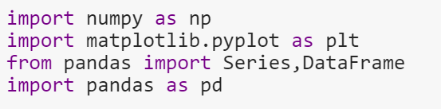
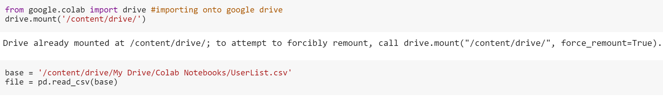

Sevan Uses Spyder
Alex uses Google Colab

Slide 5
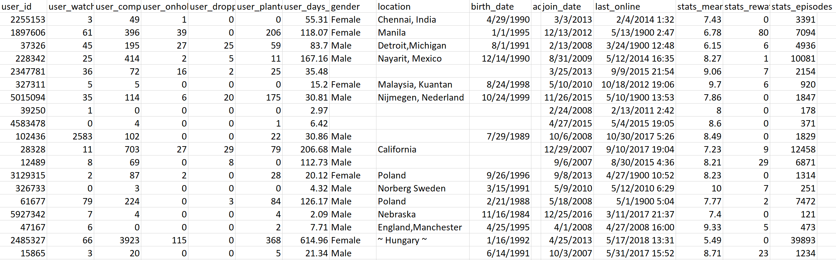
Displays a sample of users who have joined an Anime website
Type of data:
Username
User_id
User_watched
User_completed
User_dropped
User_plantowatch
Gender
Location
Birth_date
Join_date
Last online
Stats_mean_score
Stats_rewatched
Stats_episodes

Slide 6
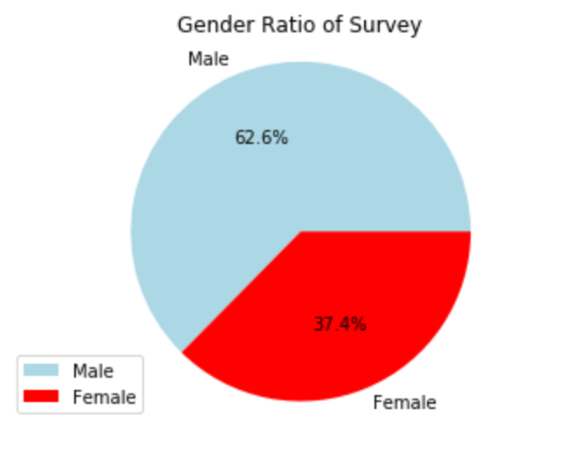
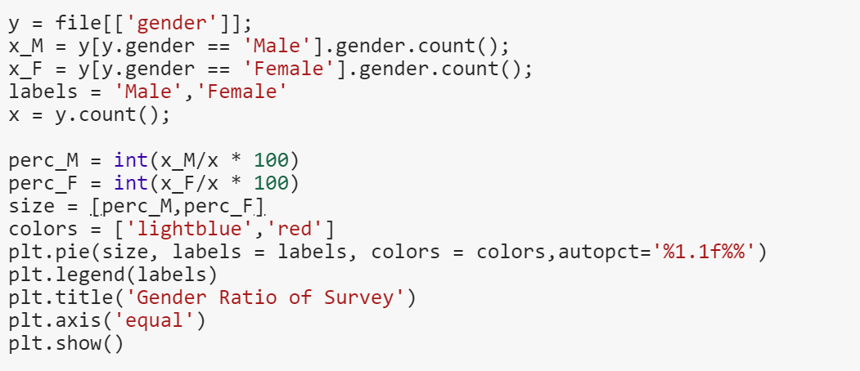
Question 1: What is the Gender Ratio between males and females in this website?
Displays the Gender Ratio between the Users of the Anime Website.
Shows that over 60% of those who watch Anime are males

Slide 7
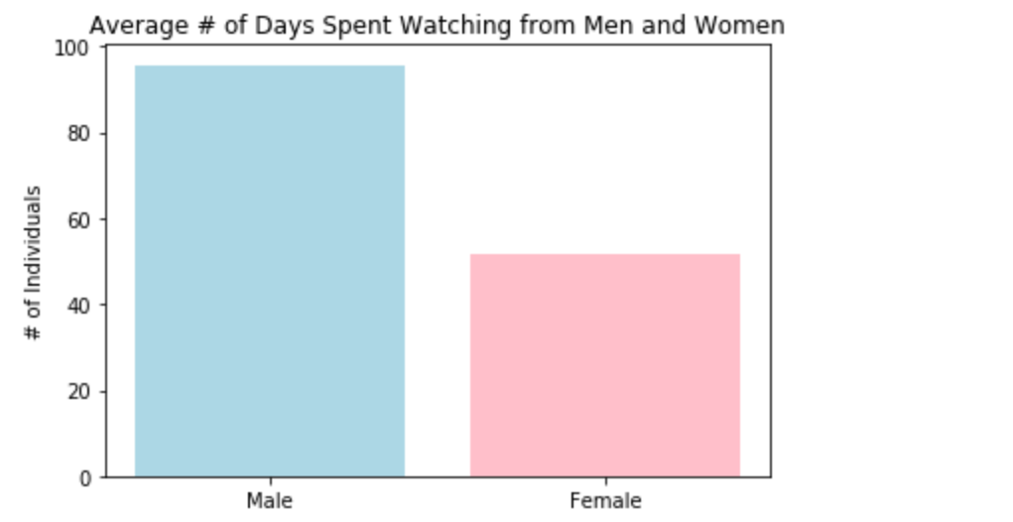
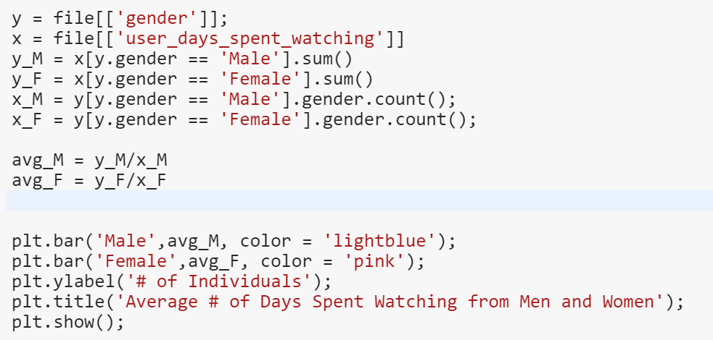
Question 2: Around how many days do men and women spend watching anime a year?
Displays the average number of days men and women spend watching anime
Men on average watch double the amount of time watching anime than women

Slide 8
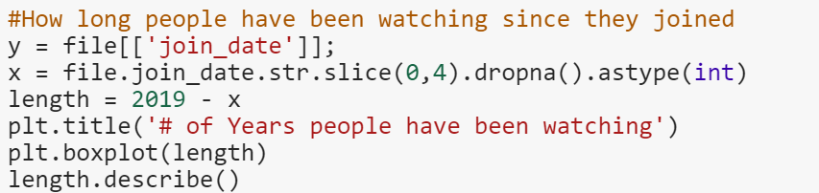
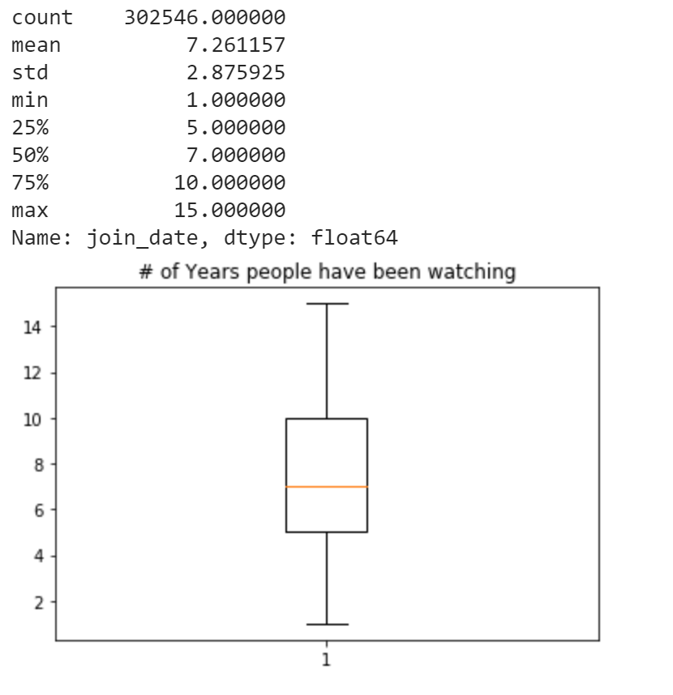
Question 3: On average, how long have users been watching anime?
Discovered the year the users started watching anime
Discovered how many years they have been watching
The users have been watching on average for 7 years

Slide 9
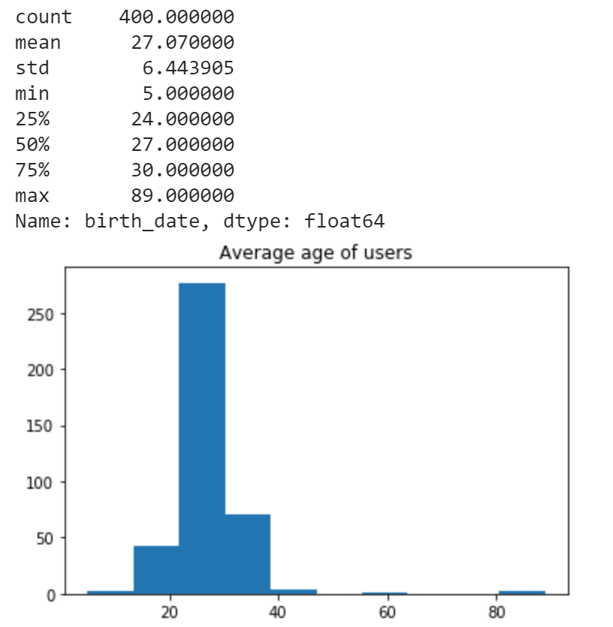
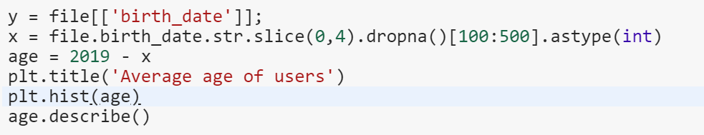
Question 4: On average, how old are the users that watch anime?
On average people who watch anime are about 24-30 years old
A lot of outliers, because some can fake their age
Had to use dropna function because many people skipped this portion of the survey

Slide 10
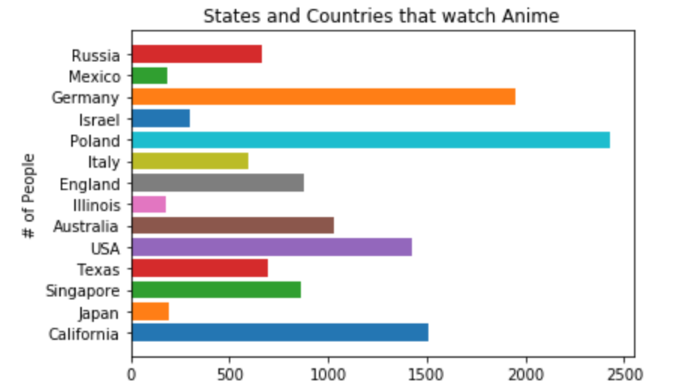
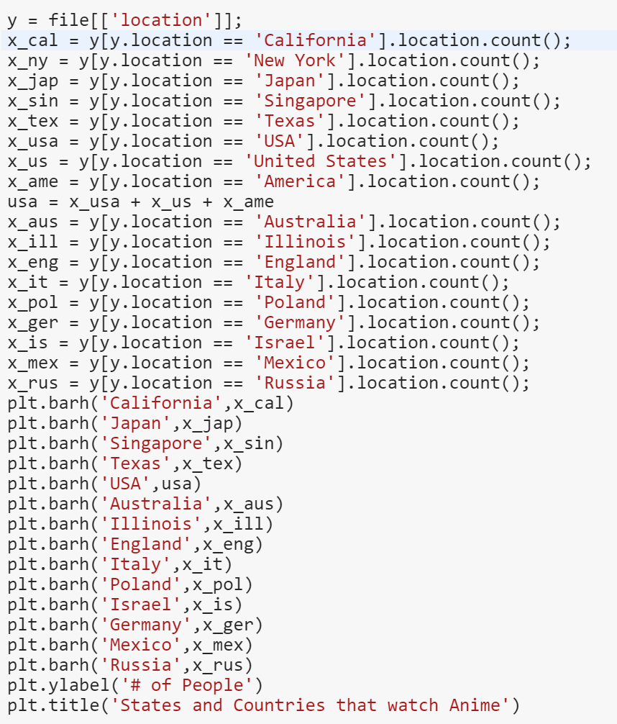
Question 5: What states and/or countries are more likely to watch anime?
Anime seems to be the most popular to Poland
Chose 15 different states and countries that appeared popular in the data
Not too trustworthy because
Some can fake it or skip the question
Many people mention state, country, and/or city, so data is inconsistent

Slide 11

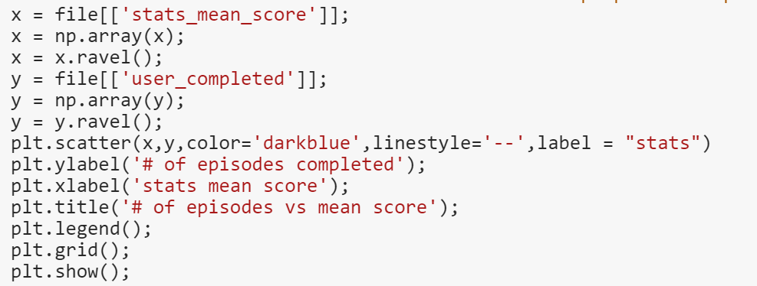
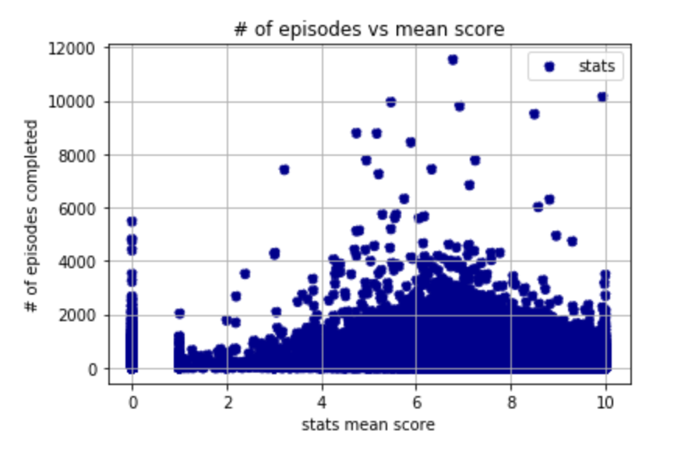
Question 6: Is there a correlation between the # of episodes completed by a user and how they rate shows?
It seems that people who rate shows positively are more likely to watch more shows
There are many people who do not bother scoring, so there are many 0s

Slide 12
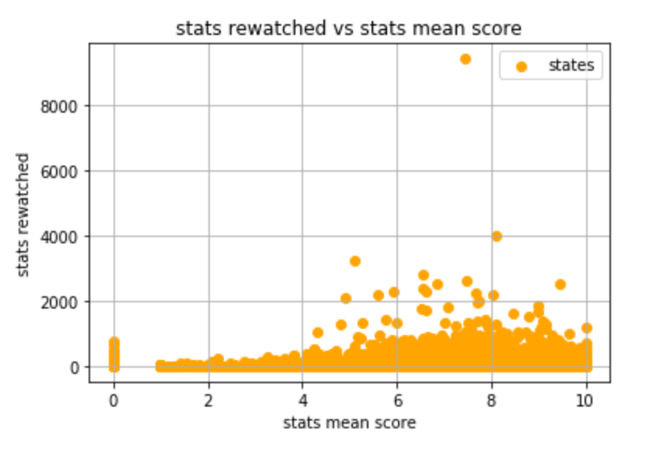
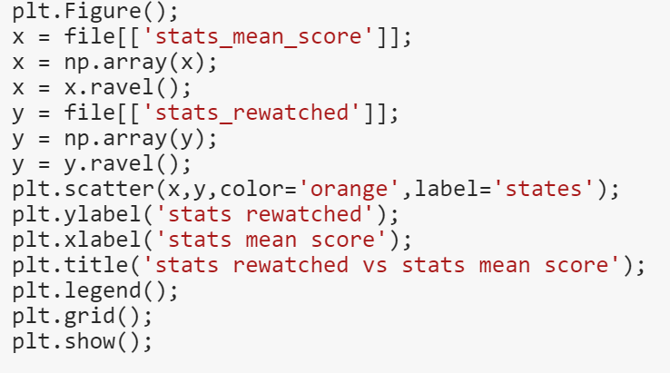
Question 7: If people rate shows well, are they more likely to rewatch shows?
People seem more likely to rewatch episodes if they have rated shows very well.
There are still a majority of people who no matter what they rate are more than likely not going to rewatch

Slide 13
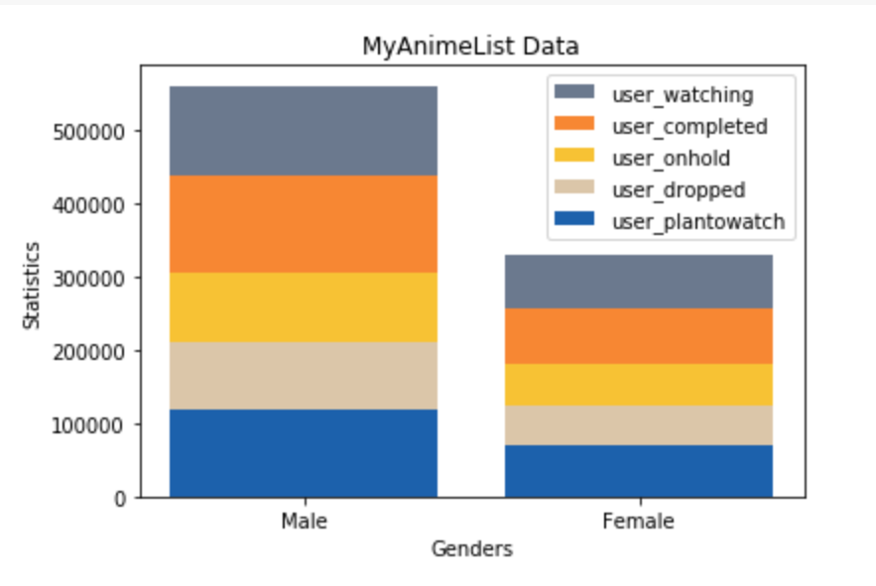
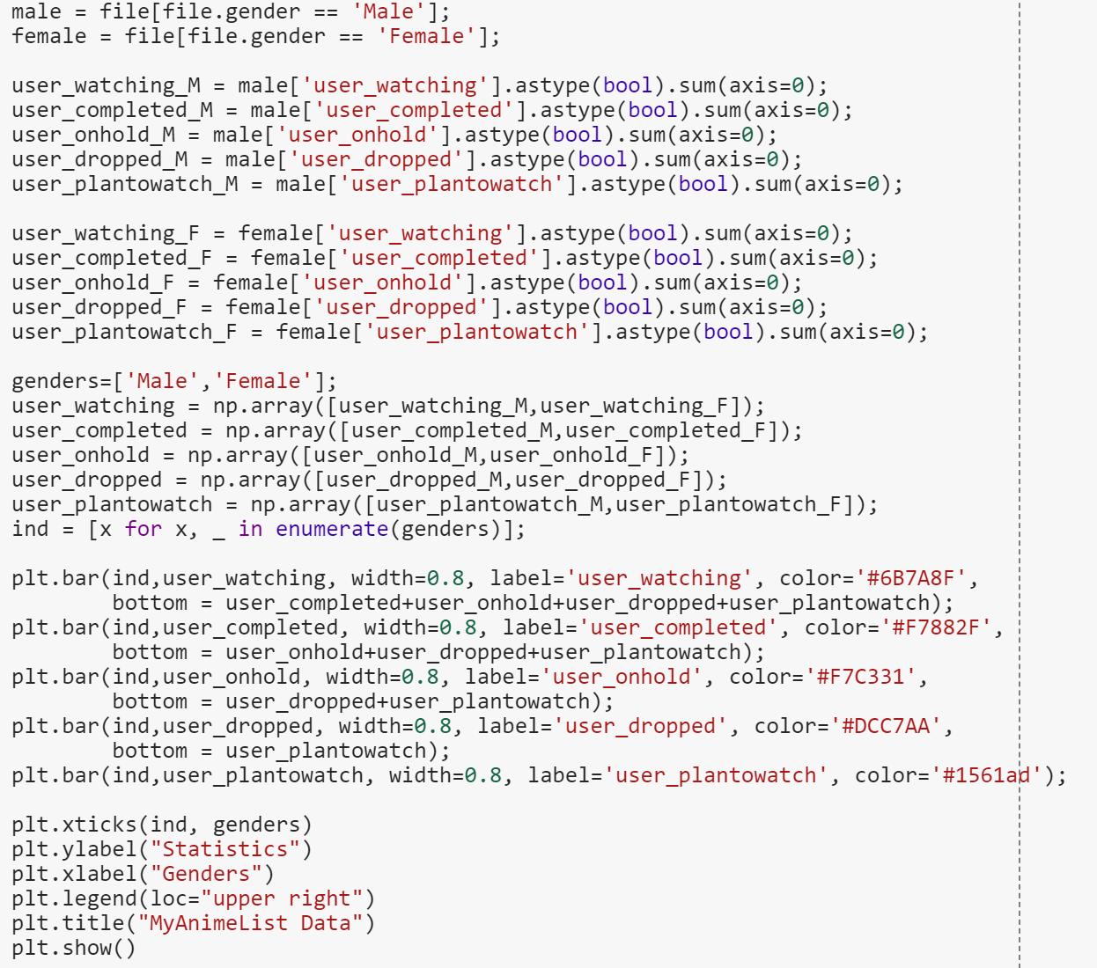
Question 8: How much have the men and women of this survey watched, completed, dropped, and placed anime on hold?
Men are more likely to spend more time with anime in general than women have?

Slide 14
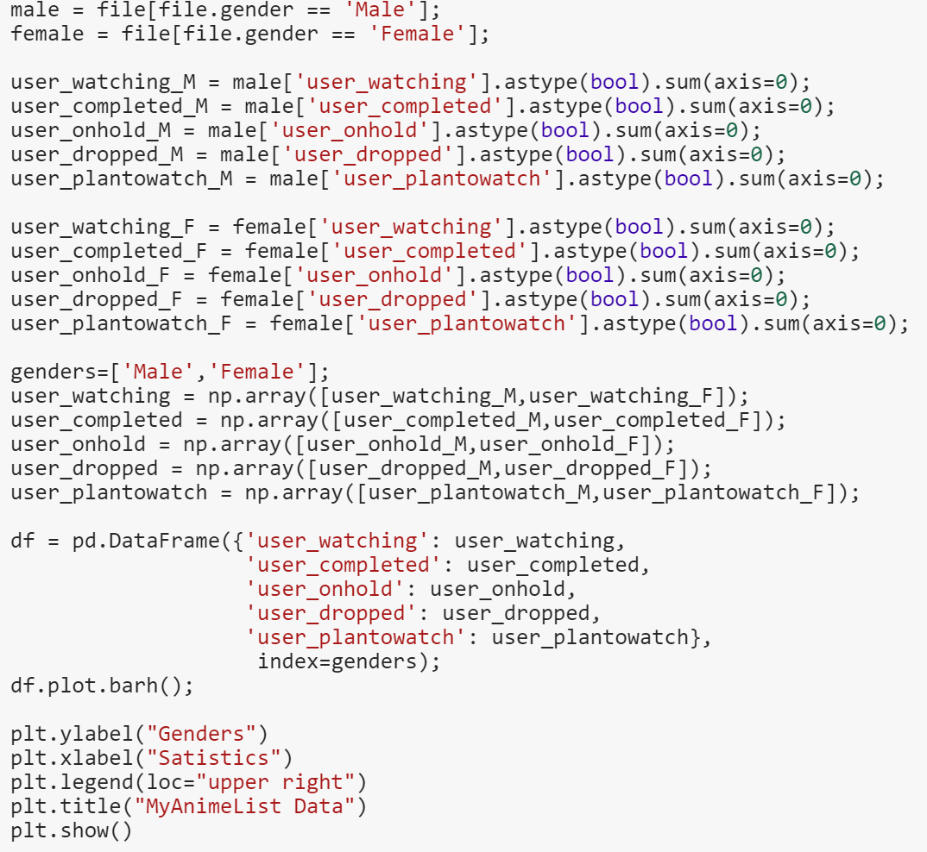
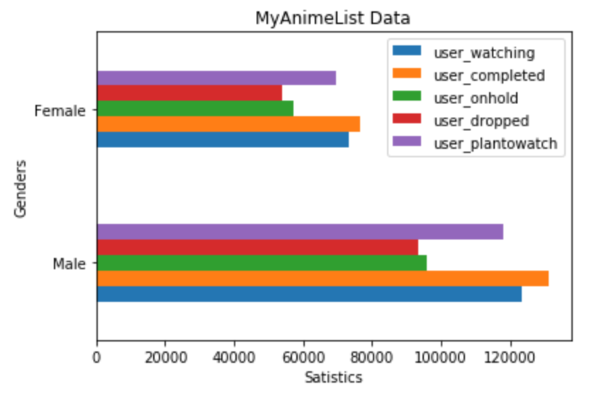
Question 9:Is there a difference between men and women in relation to how much they drop, watch, complete, and place anime on hold?
It seems that if the number of episodes watched, completed, and dropped by men and women seem to be fairly proportional
If men the number of men and women on this survey were equal, the graph would be fairy equal as well

Slide 15
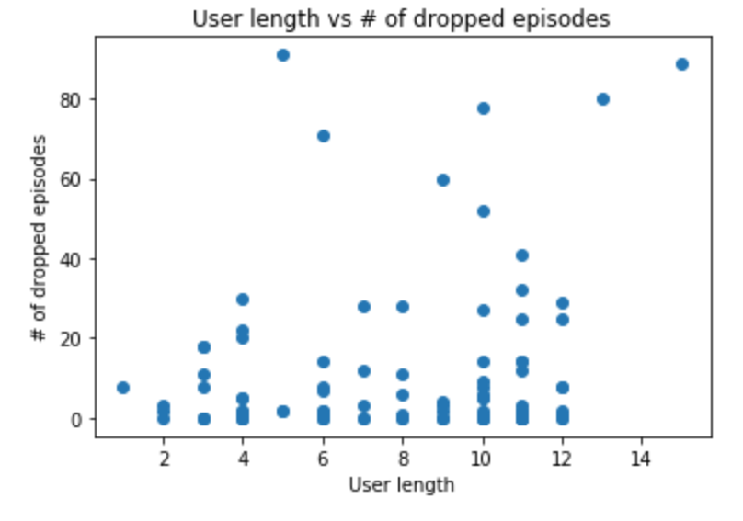
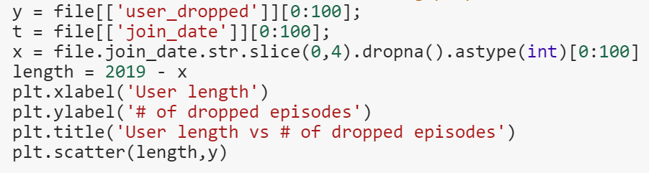
Question 10: If you have been watching anime longer, are you more likely to drop episodes?
It is slightly more likely that people will drop episodes the longer they watch
It is mostly numerous outliers of users that drop more episodes than many others.

Slide 16
Conclusion
We have discovered the targeted audience for the people who watch anime
Age: 24-30
Gender: Male
Region: Poland, Germany, California
We have discovered that people who rate anime episodes well are more likely to continuously watch episodes for the long haul
Anime companies can use this info to target ads to gain more customers

